Slide 1
Data Science Mini Project Football Data Analysis
111903094 Sejal Rahul Sarnaik
111903095 Shalaka Sunil Pawar

Slide 2

Introduction
The project is aimed at studying the FIFA football dataset, to analyze and extract information from it and make predictions based on the data.
The objective is used to derive insights and correlations between various attributes and gather information.

Slide 3
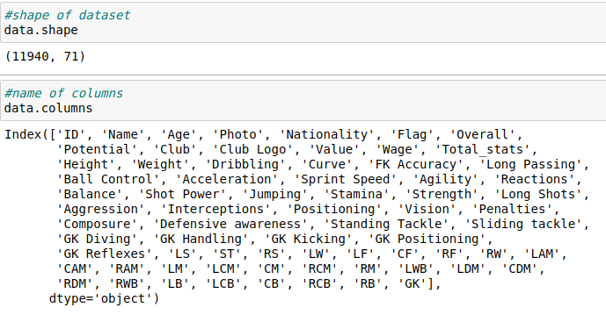
Understanding the Dataset
The data is scraped from https://sofifa.com using Beautiful Soup Python library. The scraped data is stored in CSV format.
Attributes contained in dataset are: Name, age, nationality, overall, potential, club, value, weight, height, Player strengths , players positions in football.
Dataset size:-
11940 rows and 71 columns

Slide 4
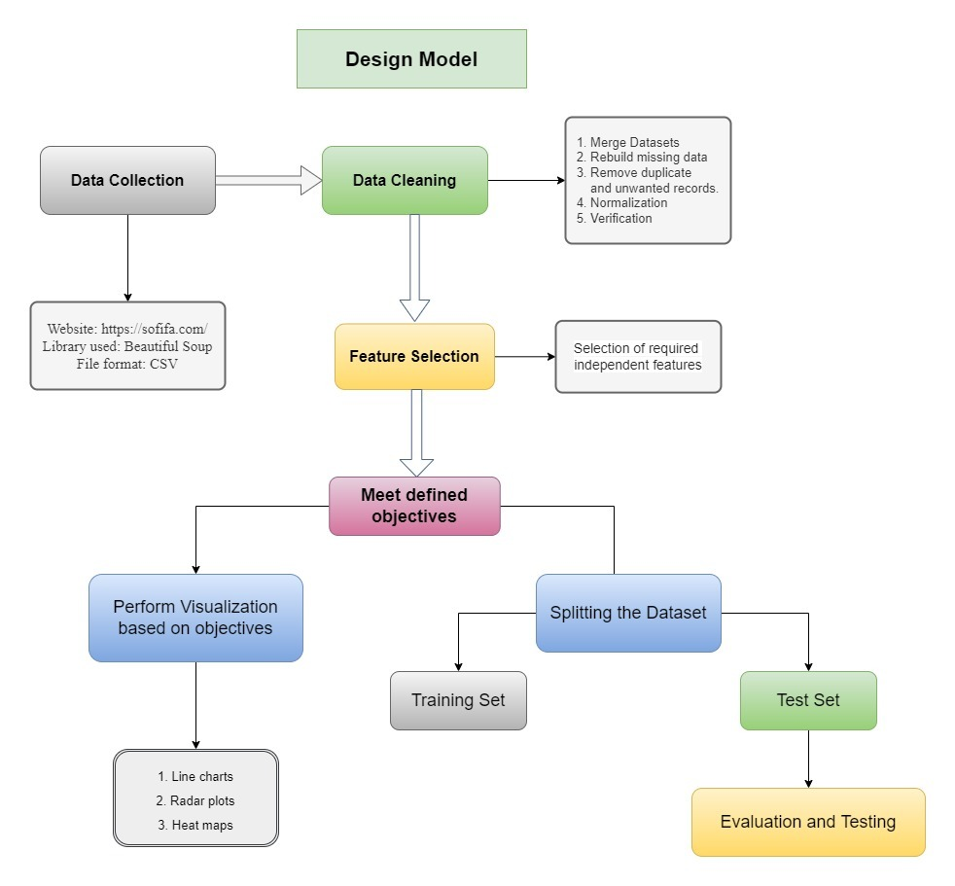
Project Pipeline

Slide 5
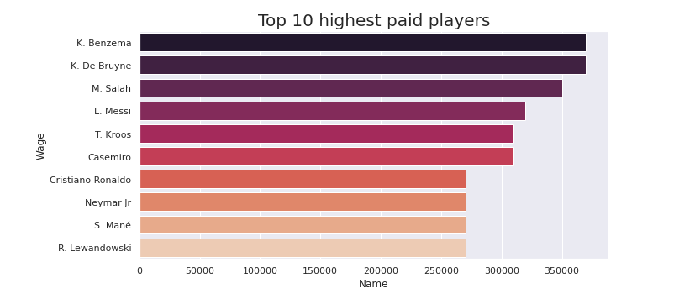
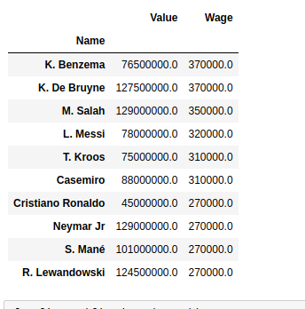
OBJECTIVES
1.FIND TOP 10 HIGHEST PAID PLAYERS IN DATASET
From this analysis we got highest paid player is K.Benzema and K.De.Bruyane with 370000 $

Slide 6
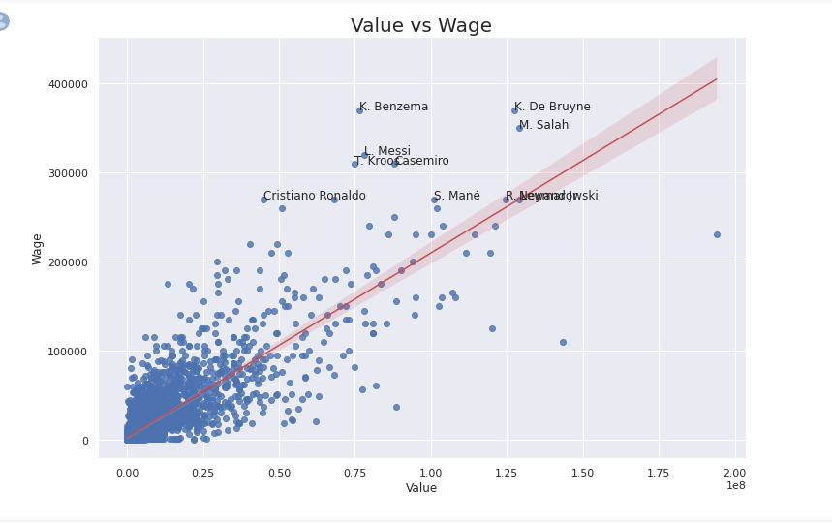
2. Analysis of players based on value and wages
Scatter Plot show a positive trend as wage tends to increase as value increases.
Scatter plot shows how the variables related and how much one variable affects the other.

Slide 7
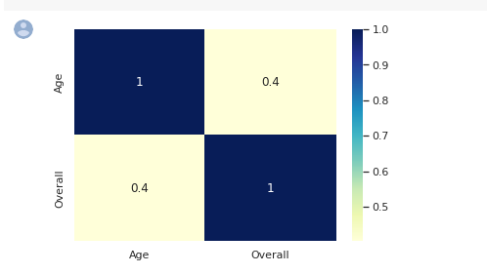
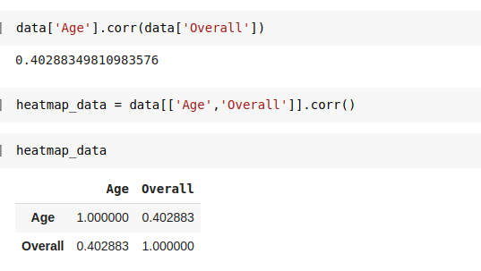
3. Co-relation Between age and overall rating.
The co-relation value between age and overall is 0.4 thus inferring the attributes aren't heavily related.
Thus age of players doesn’t affect the overall rating and vice versa.

Slide 8
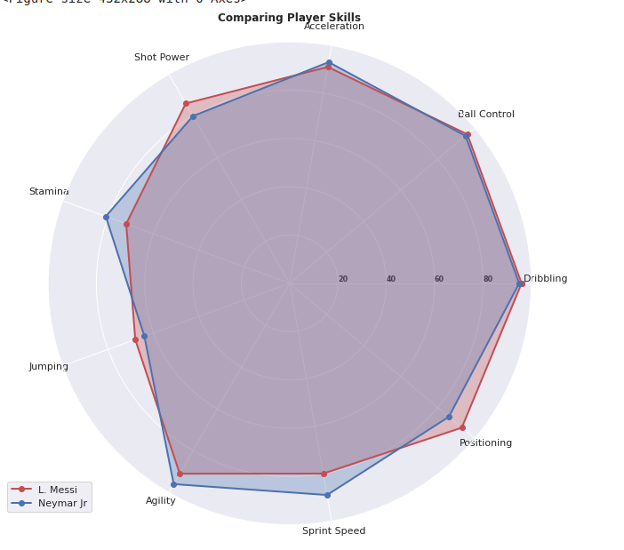
4.Visualization of the comparison between two or more players based on their attributes or skills.
Here we have compared skills of top 2 players .
We have compared 8 skills Dribbling, Ball Control, Acceleration, Shot Power, Stamina, Jumping, Agility, Sprint Speed.
Radar plot shows distribution comparison.

Slide 9
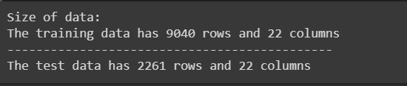
5.Predict player's overall value based on the linear regression .
Columns used are:
'Dribbling', 'Curve', 'FK Accuracy', 'Long Passing', 'Ball Control', 'Acceleration', 'Sprint Speed', 'Agility', 'Reactions', 'Balance', 'Shot Power', 'Jumping', 'Stamina', 'Long Shots', 'Aggression', 'Interceptions', 'Positioning', 'Vision', 'Penalties', 'Defensive awareness', 'Standing Tackle', 'Sliding tackle'

Slide 10
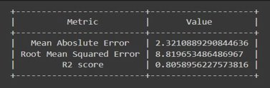
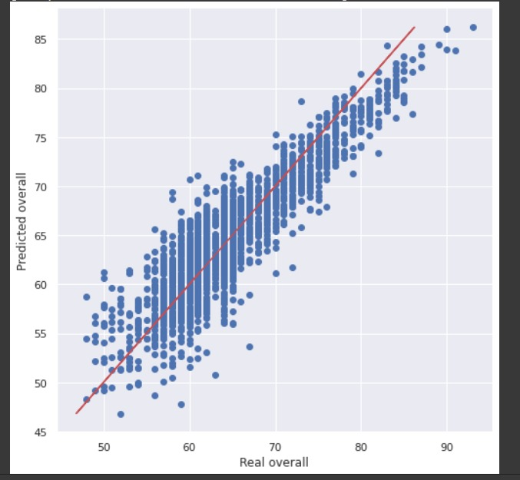
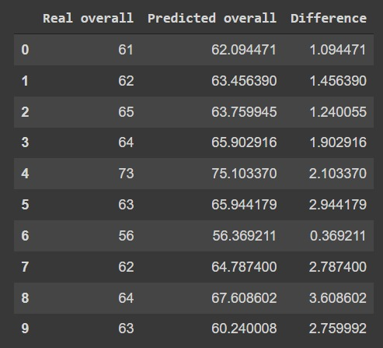
R2 Score: It is the amount of the variation in the output dependent attribute which is predictable from the input independent variable

Slide 11
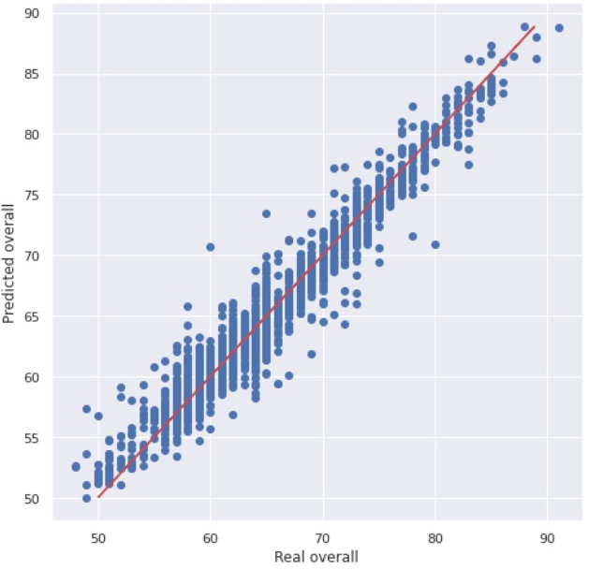
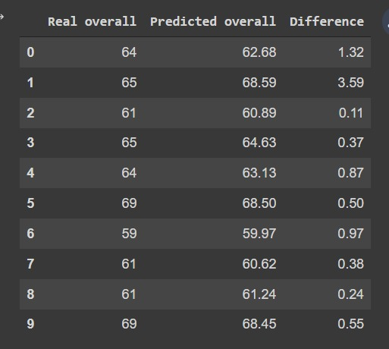
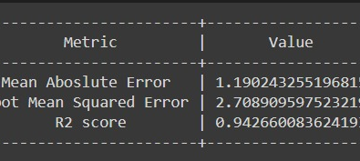
Random Forest Classifier
The contribution of attributes in overall value detection using random forest classifier.

Slide 12
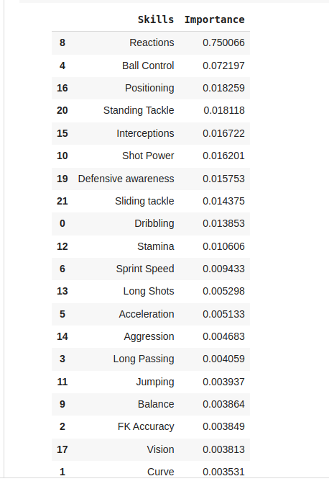
Conclusion
The project was done with the purpose of finding out factors that affected the performance of the football players, visualizing the data to depict the relation between the attributes, and training a model which accurately predicts the Overall Rating of the Player.
It was observed that the more the R2 score the better the result. More value of R2 was obtained when we used Random Forest Regression.
The important features of the Random Forest Algorithm are Reactions, Ball control, and Positioning. This means that if these factors increase, Overall Rating will increase.
We can conclude that improving the Reaction to situations on the field quality of the player will increase the overall rating of the player. Also, the player should improve their Ball control skills and work on their Positioning for better performance.

Slide 13
THANK YOU

